Slide 1






Air Traffic Management (ATM)
Group A9
Brandon Rutagamirwa | 210169058
Zhen Wei Yap | 250045280
Onur Kurt | 250914227
Staines Rajith | 250790023
Hardit Ravinder Saini | 220099811
Osinachi Odemena | 251003948
Notes:
Firstly, non-numerical features were either removed or converted to a numerical dataset such as for the type feature where arrivals were mapped to 0 and departures to 1. The IQR method was used to eliminate outliers and features with no variance such as angle error were removed as this has no contribution to the analysis.

Slide 2

Introduction
The growing global air traffic increases pressure on airport airside efficiency
Taxi time is a key operational variable influenced by congestion and airport geometry
Accurate prediction supports capacity planning and operational optimisation
The case study covered here is Manchester International Airport (MAN)
The high dimensional operational data was reduced using PCA
The three models evaluated: Linear Regression, Neural Network, and ANFIS
Notes:
The data must be prepared to remove bias and distortion. Firstly, non-numerical features were either removed or converted to a numerical dataset such as the type feature where arrivals were mapped to 0 and departures to 1. The 1.5 times IQR method was used to eliminate outliers. Features with no variance such as angle error were removed as this has no contribution to the analysis.

Slide 3
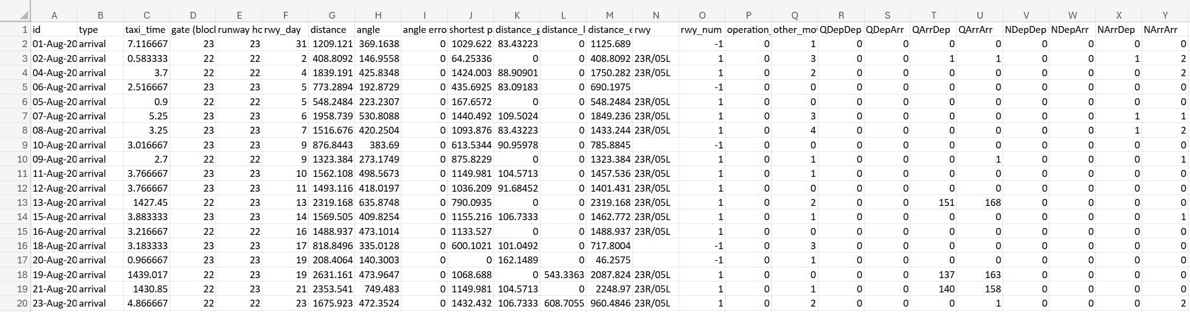

Data Pre-Processing
‘id’ and ‘rwy’ non-numerical features do not contribute to variance
‘type’ can be converted to a numerical feature
1.5 * IQR method was used to eliminate outliers
Only used on continuous features, not categorical features
Rows with null values were eliminated
‘angle error’ feature was removed as it had no variance
Notes:
The data must be prepared to remove bias and distortion. Firstly, non-numerical features were either removed or converted to a numerical dataset such as the type feature where arrivals were mapped to 0 and departures to 1. The 1.5 times IQR method was used to eliminate outliers. Features with no variance such as angle error were removed as this has no contribution to the analysis.

Slide 4
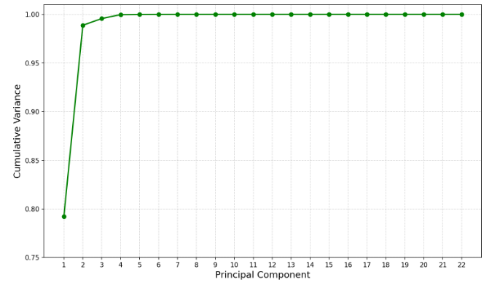


Principal Component Selection
$$Explained Variance= \frac{\sum_{i=1}^{K}{λ_{i}}}{\sum_{i=1}^{N}{λ_{i}}}$$
$$\left\|x− \hat{x}\right\|= \frac{1}{2} \sum_{i=K+1}^{N}{λ_{i}}$$
Selecting two principal components leads to significant complexity reduction while capturing 98.87% of the data variance!
Notes:
After standardizing the dataset by mean-centering the features and computing the co-variance matrix, the eigenvalues and eigenvectors form the principal components. 2 principal components was deemed to be the best balance in maintaining the underlying structure of the dataset while significantly reducing complexity.

Slide 5
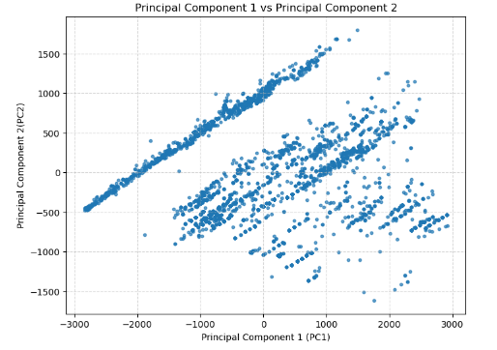
Principal Component Analysis
Notes:
The PCA plot clearly shows the larger variance that PC1 captures compared to PC2 with mainly the continuous, geometric features dominating both components. Now that the dataset dimensions are reduced, computations for training will be significantly reduced. We will now talk about the machine learning aspects.

Slide 6
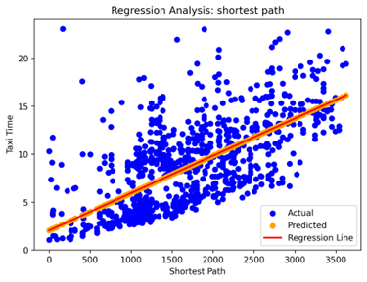
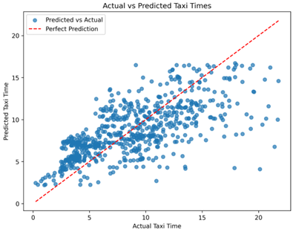
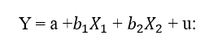
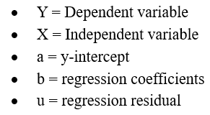
Linear Regression
Linear Regression Function:

Slide 7

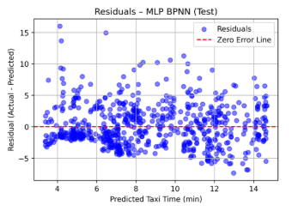
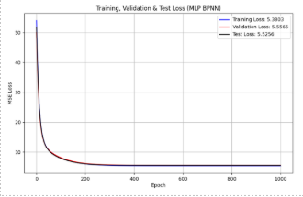
Neural Networks
Data Input
Feature-Target Separation
Feature Scaling
MLP Architecture
Input Layer (2 Neurons + Bias)
Hidden Layer (12 Neurons + Bias)
Sigmoid Activation
Weight Update
Output Layer (1 Neuron)
Linear Activation
Forward Propagation
Loss Computation
Back Propagation
Model Prediction
Notes:
it begins with data input, followed by feature–target separation and standardisation. The processed features are passed into a multi-layer perceptron with two input neurons, a single hidden layer of twelve neurons using sigmoid activation, and a linear output layer. Forward propagation is used to generate predictions, the error is computed using mean squared loss, and backpropagation updates the weights iteratively until convergence, producing the final taxi-time prediction.

Slide 8
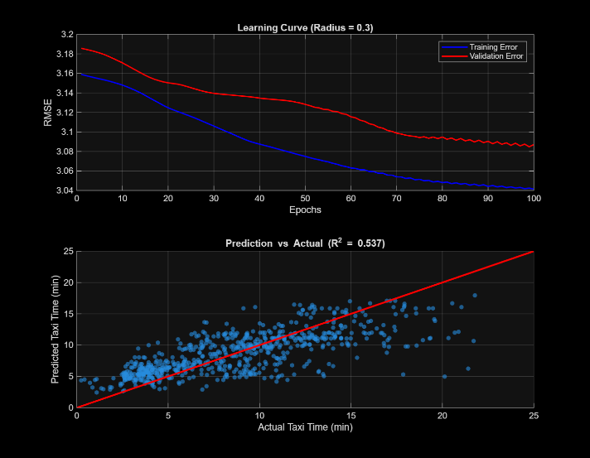
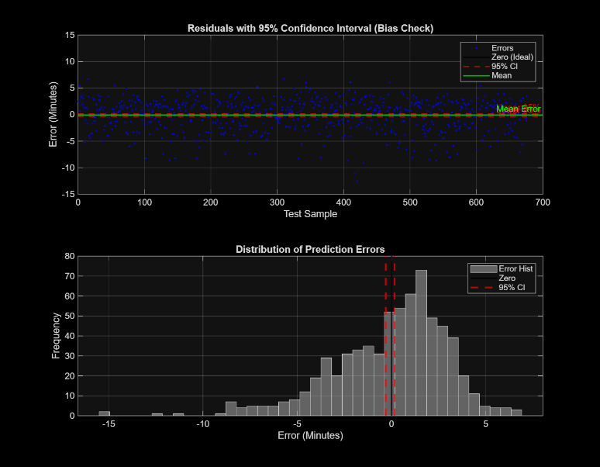
ANFIS
Cluster Radius | RMSE | MAE | R2
0.25 | 3.0958 | 2.3433 | 0.5308
0.30 | 3.0736 | 2.3598 | 0.5375
0.50 | 3.1978 | 2.4897 | 0.4994
Notes:
Staines: We evaluated the ANFIS model's performance across three cluster radii to identify the optimal setting. As shown in the table, the model with a cluster radius of 0.30 was the clear winner. It achieved the lowest RMSE (3.07) and the highest R-squared. Below are the graphs for the optimal model, which confirm the result. The top learning curve shows a smooth reduction in error, and the bottom regression plot shows a tight fit between the predicted and actual values, proving the model generalises well.
Onur: To ensure this accuracy wasn't accidental, we statistically validated the model. Looking at the charts on the left, the residuals are centred around zero with a mean error of just -0.07. This confirms the model is unbiased and the errors follow a normal distribution. Finally, with respect to the logic, the model generated eight specific inference rules. These rules created a direct one-to-one mapping: if the inputs belong to a particular cluster, the output is mapped directly to that cluster.

Slide 9
Comparison
Aim
Compare Linear Regression (LR), Neural Network (NN), and ANFIS based on these evaluation criteria:
Prediction accuracy
Generalisation
Model transparency
 | LR | NN | ANFIS
RMSE (min) | 3.33 | 3.32 | 3.07
R² | 0.44 | 0.46 | 0.54
Statistical Reliability
LR and NN:
Residuals centred around zero, ANFIS shows narrower confidence interval
ANFIS residuals:
Mean error = –0.07 min, 95% confidence interval includes zero
Generalisation
LR: Linear model → underfitting complex taxi dynamics
NN: Stable convergence after 300 epochs, Similar performance to LR
ANFIS: Strong generalisation, Balanced training and validation errors
Model Transparency
LR: Fully interpretable coefficients
NN: Black-box model with limited interpretability
ANFIS: Semi-interpretable fuzzy rules
Notes:
This slide compares linear regression, a neural network, and ANFIS across prediction accuracy, generalisation, and transparency. ANFIS performs best, achieving the lowest RMSE of 3.07 minutes and the highest R² of 0.54, while linear regression and the neural network show similar but weaker performance. Linear regression underfits complex taxi dynamics, and although the neural network converges stably, it offers limited improvement. ANFIS generalises well and balances accuracy with partial interpretability through fuzzy rules.

Slide 10
Conclusion
Key Takeaways:
ANFIS achieved the BEST performance
RMSE = 3.07 min, R² = 0.54
Best balance between prediction accuracy and interpretability
Neural Network: strong learning but limited transparency
Linear Regression: underfits nonlinear taxi dynamics
How this Study Benefits:
The growing global air traffic increases pressure on airport airside efficiency
Taxi time is a key operational variable influenced by congestion and airport geometry
Accurate prediction supports:
capacity planning
operational optimisation
High dimensional operational data was reduced using PCA
The three models evaluated: Linear Regression, Neural Network, and ANFIS
Notes:
In conclusion, ANFIS achieved the best performance, offering the strongest balance between accuracy and interpretability. While the neural network showed strong learning, its black-box nature limits transparency, and linear regression underfit the nonlinear taxi dynamics. This study demonstrates how accurate taxi-time prediction, using PCA-reduced operational data, can support capacity planning and operational optimisation at busy airports.

